Slide 1
:ssergiT
Tigress:
A Source-to-Source-ish
hsi-ecruoS-ot-ecruoS A
looT noitacsufbO edoC
Code Obfuscation Tool
SSPREW 2018
Christian Collberg
University of Arizona
Notes:
Thank you for that introduction.

Slide 2
Obfuscation: still a thing
Tigress design
Generic transformations:
Dynamic
Virtualize
Anti Taint
Applications
Notes:
Today I am going to talk about three things:
First
I’m going to show you some of the history behind code obfuscation, and
Then I’m going to show some new applications of obfuscation to convince you that, even though people have been saying for years that it’s a useless technology, it is, actually, still a thing.
And, finally, I will show you some new obfuscation tricks that may help us extend the game between attackers and defenders for a little longer.

Slide 3
Obfuscation: still a thing
Tigress design
Generic transformations:
Dynamic obfuscation
Virtualization
Generic De-Obfuscation
Anti-Taint Analysis
Tigress Applications
Notes:
Today I am going to talk about six things:
First
I’m going to show you some of the history behind code obfuscation, and
Current applications of obfuscations, to show that, it is, actually, still a thing.
Then we will look at the design of the Tigress source-to-source obfuscator
Then we’ll talk about two obfuscating transformations, dynamic obfuscation, and virtualization. Both these are “generic” in the sense that they incorporate many different techniques that have been proposed previously
Then we’ll talk briefly about an attack on these types of transformations, namely generic de-obfuscation
Then we’ll talk about a counter-attack on dynamic de-obfuscation, namely anti-taint analysis
And, finally, we’ll conclude with a discussion about ways in which people use Tigress.

Slide 4


main(){
}
A Code Obfuscator transforms a program into one that is harder to analyze and reverse engineer
Source
Algorithms
Keys
Media
Integrity Checks
Code Obfuscator
main(){
}
Obfuscating
Transformations
Max complexity
Min overhead
Notes:
Today, I’m going to talk about the design of a code obfuscator.
A code obfuscator is essentially a compiler that takes a program as input and produces a new program as output, using a set of code transformations.
An obfuscator tries to increase the complexity of the program, while at the same time minimizing overhead.
Typically, there is some asset in a program that we’re trying to protect, symbolized by the diamond here.
This asset could be the source code itself, valuable algorithms, cryptographic keys, media that we’ve downloaded, the integrity of some security checks that we want to protect, etc.

Slide 5



main(){
}
Max protection!
Min overhead!
Max precision!
Min resources!
Obfuscation Tool
De-Obfuscation Tool
Obfuscation
Emulation
Anti-Tamper
Debugging
Whitebox
Static
Env. Check
Dynamic
Notes:
So, how does this work in practice? Well, both Alice and Bob rely on tools to protect and attack programs.
Alice, who wants to defend her program, uses protection tools that provide obfuscation, tamperproofing, and other protective code transformations to transform her program into one that is somewhat safer against attack.
Unfortunately, these transformations all come at a cost:
Alice wants to maximize the amount of protection she gets against attack,
while minimizing the overhead.
Bob, on the other hand, uses program analysis tools to try to extract the assets from Alice’s application. These tools provide static analysis, dynamic analysis, concolic analysis, disassembly, etc.
Bob also cares about performance:
he wants the analyses to be as fast as possible,
use as little memory as possible,
and be as precise as possible.
So, to continue this rodent analogy ad nauseam, Alice wants to engineer faster, leaner mice, and Bob wants to build a better mousetrap. And if you watched Tom and Jerry cartoons as a kid, you know the battle never ends.

Slide 6
int next=0;
for(;;)
switch(next) {
case 0: …; next=1; break;
case 1: if (…) next=2;
else next=6; break;
case 2: if (…) next=3;
else next=4; break;
case 3: …; next=5; break;
case 4: …; next=5; break;
case 5: s…; next=1; break;
case 6: return L;}
}
Flatten
Notes:
Here’s an example of a common obfuscating transformation, called flattening, that removes obvious control flow from a function. You can see the original control flow graph here, and then the obfuscated one.
And here is the corresponding obfuscated source code.
As you can tell, the transformed code is more complex, larger, and probably quite a bit slower than the original.
There are hundreds of these transformations described in the literature.
This particular one targets control flow, but there are other transformations that target data, abstractions, etc.

Slide 7
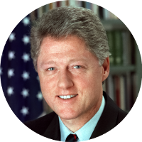
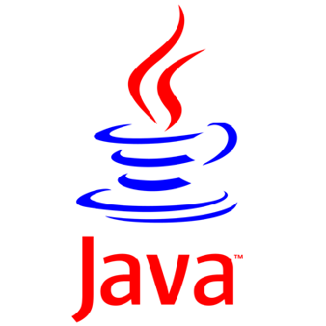


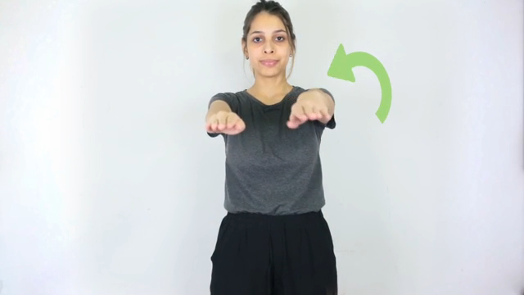


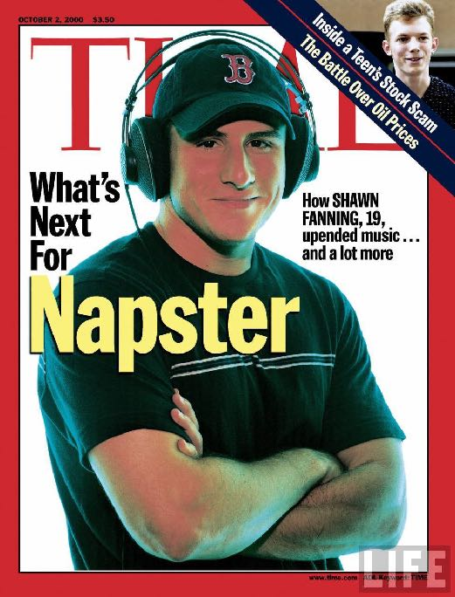
Protect
OS
Against
Malware
Protect
Viruses
Against
Anti-Virus
Protect
Java
Against
IP Theft
Protect
Against
Media
Theft (DRM)
1990
1999
Notes:
When did this all start?
A long long time ago, in the 1990s, not only did we see the death of the Soviet Union and the birth of the Macarena, but a number of people independently thought about code obfuscation as the solution to different security problems.
And this includes
Protecting media against illegal copying, what we now call Digital Rights Management;
Protecting viruses from being detected by anti-virus scanners
Protecting Operating Systems from malware, and
Protecting the intellectual property in Java programs from theft.
So, let’s talk about these in some more detail.

Slide 8
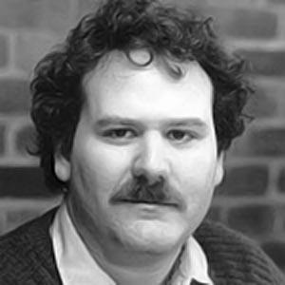

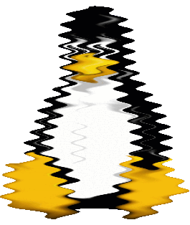
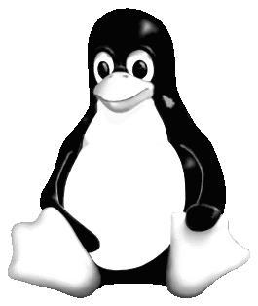


Operating System Protection
Through Program Evolution
By Dr. Frederick B. Cohen
October 1993
Seed
Code Obfuscator
Diversifying
Transformations
Notes:
The first one to think in these terms, at least in the academic literature, might have been Fred Cohen.
In a paper from 1993 he talks about how to protect operating systems from malicious code.
In particular, he was worrying about the monoculture of operating systems:
once you find a vulnerability, you can exploit it everywhere, since all installations of an operating system tend to be more-or-less the same.
Cohen’s idea was to use diversification.
The idea is to generate multiple different instances of the same program so a successful attack on one instance doesn’t help with an attack on a second instance.
As some of you may know, Fred not only invented code obfuscation, but he also invented Computer Viruses for his PhD thesis. Busy guy.

Slide 9








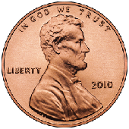
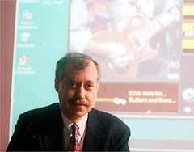




United States Patent
Ginter et al.
Patent Number: 5,892,900
Date of Patent: Apr. 6, 1999
SYSTEM AND METHODS FOR SECURE
TRANSACTION MANAGEMENT AND
ELECTRONIC RIGHTS PROTECTION
Customer
Producer
Banker
Artist
Victor Shear
Publisher
Notes:
Around the same time, in 1990, Victor Shear started a company called InterTrust. Victor was a real visionary.
his vision was to create an online marketplace for digital goods;
letting you buy/rent/redistribute music online;
such that income from consumers would flow back to the producers.
A powerful part of Victor’s powerful vision was that for every transaction, a fraction of a cent would flow back to Victor, and to InterTrust.
Being the first with this vision, he was able to file patents on just about anything that moved. This particular patent from 1999 is over 350 pages long.
So what does this have to do with code obfuscation? Well, InterTrust soon realized that the big gaping hole in their design was the media player (iTunes, these days), which is under control by a, possibly malicious, end user.
So, they explored the use of obfuscation to prevent tampering with the security checks in the media player.
Unfortunately, in 1999 Napster started distributing music for free and InterTrust turned to the much more lucrative business of suing Microsoft for patent infringement.

Slide 10
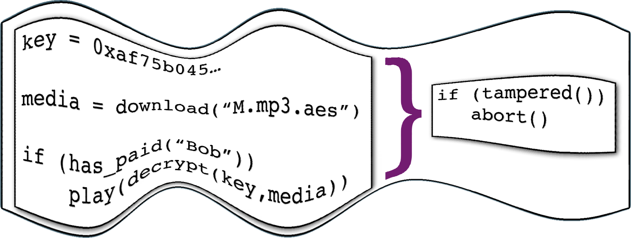
}
key = 0xaf75b045…
media = download(“M.mp3.aes”)
if (has_paid(“Bob”))
play(decrypt(key,media))
if (tampered())
abort()
Notes:
So what does this have to do with code obfuscation?
Well, InterTrust soon realized that the big gaping hole in their design was the media player:
to be able to decrypt music files it needs to contain a decryptor and an embedded key.
And a malicious end user could reverse engineer the player, and extract the key.
So, they had to insert security checks to prevent tampering.
But, that wasn’t enough, you also had to protect the security checks themselves!
And, so the idea was to use of code obfuscation to camouflage security checks.
Unfortunately, in 1999 Napster started distributing music for free, and it was all over.
InterTrust then turned to the much more lucrative business of suing Microsoft for patent infringement.

Slide 11
}
key = 0xaf75b045…
media = download(“M.mp3.aes”)
if (has_paid(“Bob”))
play(decrypt(key,media))
if (tampered())
abort()
Ekey( )
Notes:
What’s going on here is that
the user downloads an encrypted music file
but, to be able to decrypt music files the player needs to contain a decryptor and an embedded key.
And a malicious end user could reverse engineer the player, and extract the key.
So, they had to insert security checks to prevent tampering.
But, that wasn’t enough, you also had to protect the security checks themselves!
And, so the idea was to use code obfuscation to camouflage security checks.
Unfortunately, in 1999 Napster started distributing music for free, and it was all over.
InterTrust then turned to the much more lucrative business of suing Microsoft for patent infringement.

Slide 12
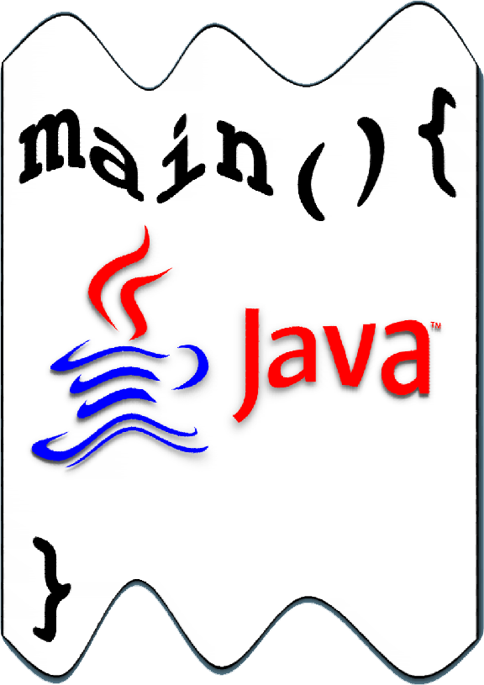
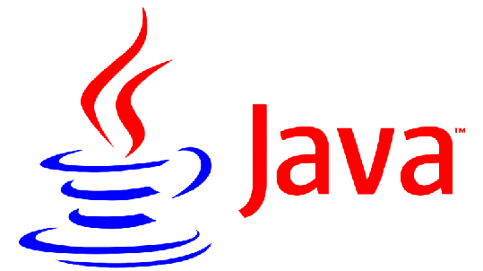
A Taxonomy of Obfuscating Transformations
Christian Collberg Clark Thomborson. Douglas Low
July 1997
Mocha
Decompiler
Code Obfuscator
main(){
}
main(){
}
Obfuscating
Transformations
Java 1.0, 1995
Notes:
In 1995, Java 1.0 was released.
A year later the first decompiler of Java bytecode appeared, called Mocha.
Java developers had a collective hissy fit when they realized that all the intellectual property in their Java programs was for the taking.
A year after that, we wrote this paper on how to obfuscate Java byte code to prevent intellectual property theft.

Slide 13

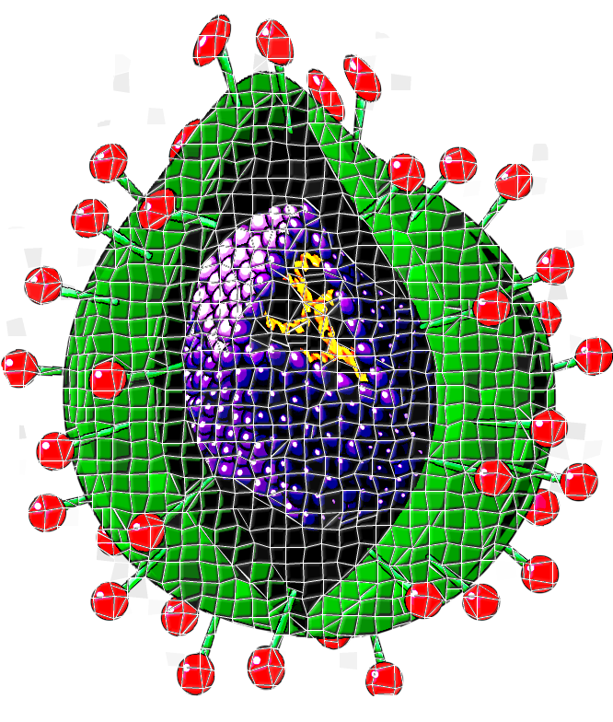
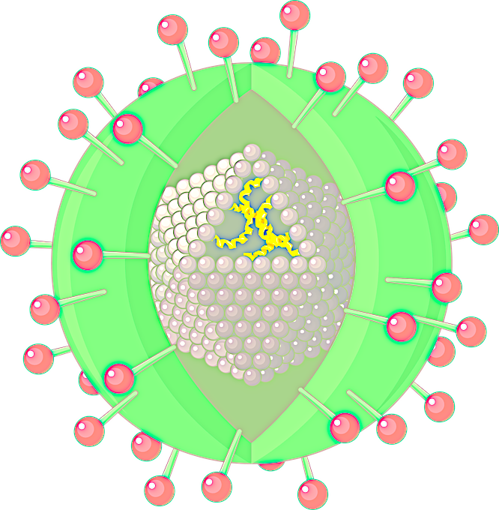

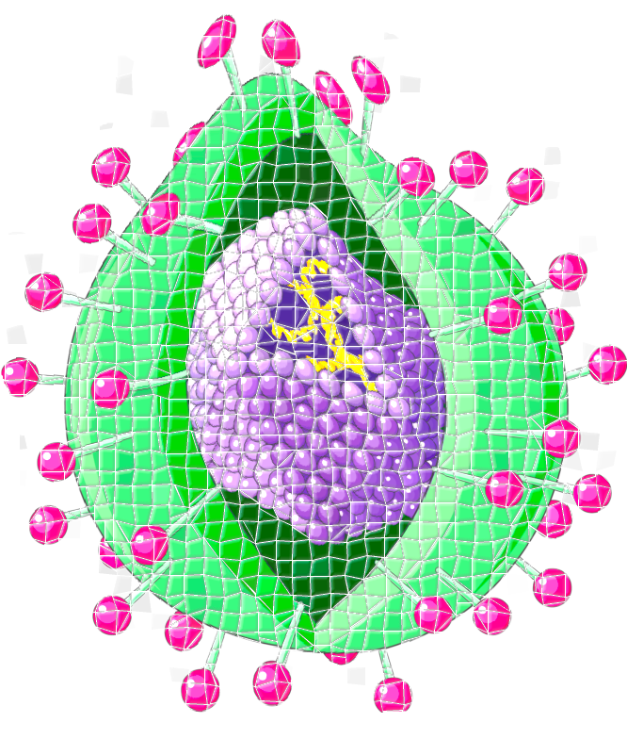
The Mutation Engine -
The Final Nail?
April 1992
Virus
Scanner
Dark Avenger
Mutation Engine
Stealth
Transformations
Diversifying
Transformations
Notes:
Obfuscation of course have a long history in the malware world.
The first general obfuscation tool targeted at malware was called the “Dark Avenger Mutation Engine” and was released in 1992.
The idea, of course, is to generate many versions of the same virus, all different enough so that they cannot be picked up by virus scanners.
So, another application of diversification.

Slide 14
Man-At-The-End (MATE) attacks occur in any setting where an adversary has physical access to a device and compromises it by inspecting, reverse engineering, or tampering with its hardware or software.
?
Extract keys
Recover source
Detect
Tamper
main(){
}
Notes:
Lately, we have taken to call these type of scenarios “Man-At-The-End Attacks”. We say that
MATE attacks…
And as we’ve seen from these examples, the goal of a MATE attack is typically to extract keys or other data, recover the source code, detect the presence of certain types of code, or to tamper with the code.
Ok, but we’re not in the 1990s anymore - so what happened with these MATE scenarios? Well,
DRM appears to be on its way out. Already, Apple’s iTunes has removed all the DRM from music files;
Diversity to avoid the monoculture problems is something people have reinvented multiple times in the last 25 years, but it never caught on because of various practical issues;
I recently talked to a bunch of anti-virus guys, and they said that they see very little heavy duty obfuscation in malware these days;
And, finally, a recent study shows that Android developers apply minimal obfuscation to their Java apps, mainly because they don’t think their code has much intellectual property worth protecting.
So, that gets us back to the original question: Is Obfuscation Still A Thing, and if so, why?

Slide 15
Man-At-The-End (MATE) attacks occur in any setting where an adversary has physical access to a device and compromises it by inspecting, reverse engineering, or tampering with its hardware or software.
Notes:
Lately, we have taken to call these type of scenarios “Man-At-The-End Attacks”. We say that
MATE attacks…

Slide 16


?
main(){
}
Extract keys
Recover source
Detect
Tamper
Notes:
And as we’ve seen from these examples, the goal of an attack is typically to extract keys or other data, recover the source code, detect the presence of certain types of code, or to tamper with the code.
Ok, but we’re not in the 1990s anymore - so what happened with these scenarios? Well,
DRM appears to be on its way out. Already, Apple’s iTunes has removed all the DRM from music files;
Diversity to avoid the monoculture problems is something people have reinvented multiple times in the last 25 years, but it never caught on because of various practical issues;
I recently talked to a bunch of anti-virus guys, and they said that they see very little heavy duty obfuscation in malware these days;
And, finally, a recent study shows that Android developers apply minimal obfuscation to their Java apps, mainly because they don’t think their code has much intellectual property worth protecting.
So, Is Obfuscation Still A Thing, and if so, why?

Slide 17









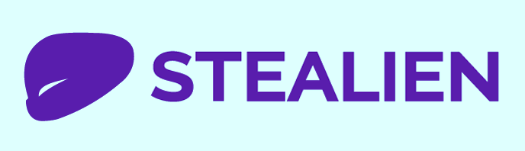










1990
2000
2010
Market Guide for
Application Shielding
June 2017
Notes:
Well, it actually appears as if obfuscation is picking up steam, at least in the corporate world.
Gartner recently published a market guide for what they call “Application Shielding”, and they list 19 companies in the space, many of which appeared fairly recently.
So, let’s look at some more recent scenarios where code obfuscation could be a useful security primitive.

Slide 18
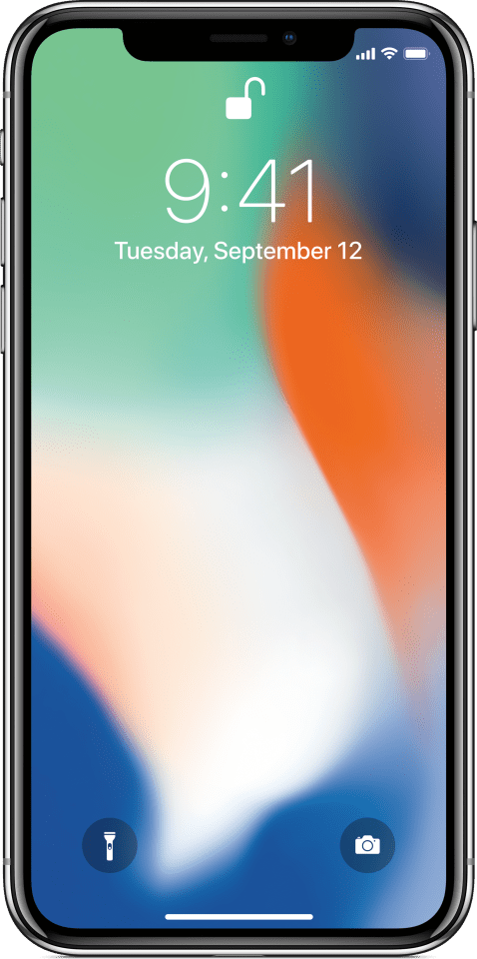


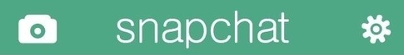
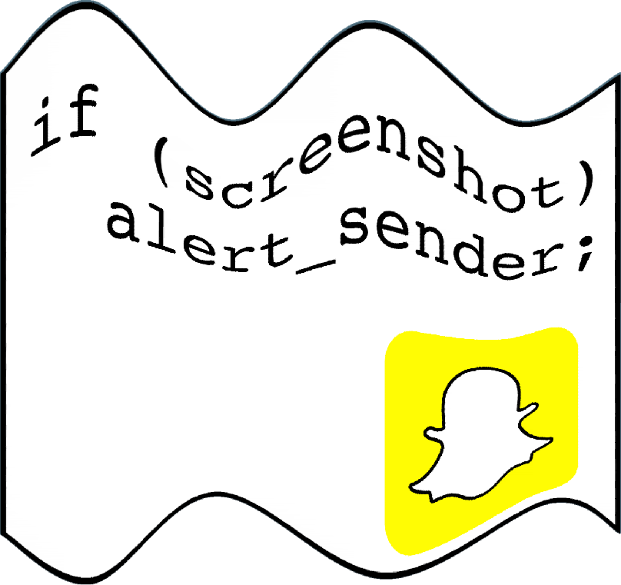

Bob took a screenshot!
false
if (screenshot)
alert_sender;
Notes:
This is Alice, your teenage daughter. She’s using Snapchat to take a picture of herself to send to her boyfriend Bob.
She sets a timeout so that after 8 seconds the picture will be deleted off his phone.
But before that happens, Bob manages to take a screenshot to save the picture for later.
Now this is a breach of Alice’s privacy, of course, so Snapchat has added code that makes an alert pop up on Alice’s phone, whenever Bob takes a screenshot.
And so she can un-friend him, or whatever the kids do these days.
Now, Bob isn’t deterred, of course, so he hacks the snapchat app to allow him to take a screenshot without Alice finding out.
But, in response to this attack, Snapchat now tamperproofs and obfuscates their code to make it harder for Bob to hack.

Slide 19

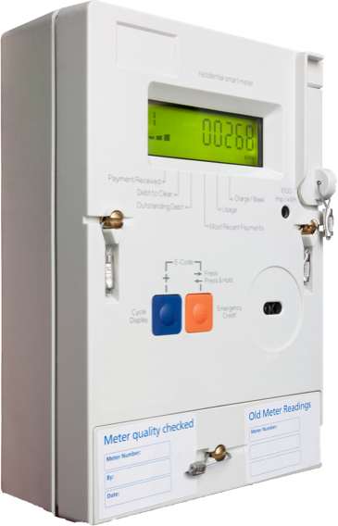



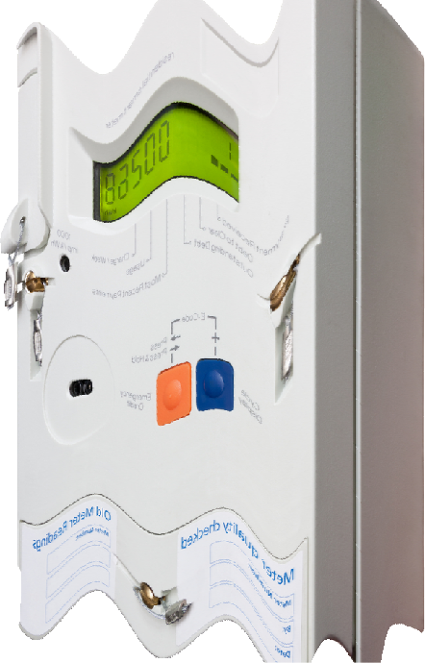
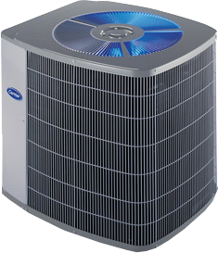
Off!
0 kWh!
Off!
Cleemput, Mustafa, Preneel, High Assurance Smart Metering
Notes:
In this next scenario, Alice runs a public utility, such as a power company.
Bob is a customer, and outside his house there’s a smart meter that sends back his consumption in real time.
Of course, he’d rather not pay for electricity, and so he tampers with the meter so it sends back the wrong information.
These meters not only measure consumption, they also allow the utility company to turn power on and off, in case there is an acute power shortage.
Here, Bob, the evil terrorist,
tampers with the meter, and
sends out 5 millions disconnect notices to all the smart meters on Manhattan,
causing global financial meltdown.
And, in response, the power company obfuscates and tamperproof their smart meters against these sort of attacks.

Slide 20
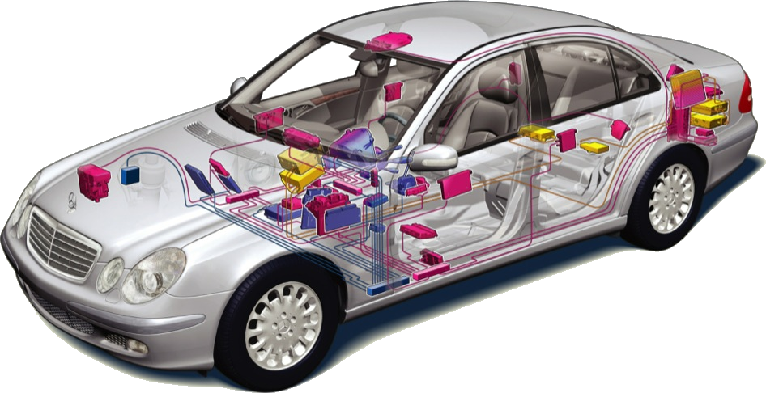

false
battery_management() {
valuable trade secrets
}
true
if (reported_stolen())
send_GPS_coords();
if (has_paid_for_upgrade())
allow_ridiculous_mode = 1;
Notes:
These days, your car contains hundreds of processors which are networked with each other and the outside world.
This scenario is also similar to what we’ve seen already, because Bob, the car owner, is in complete control of his car and can attack it at will.
So, what might he do?
For example,
He could roll back the odometer.
He could enable software features he hasn’t paid for;
He could tamper with a car he has stolen so that it won’t phone home its GPS coordinates;
He could steal valuable algorithms;
And, most seriously, he could tamper with the car to cause harm to passengers or other citizens.

Slide 21


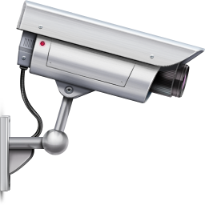
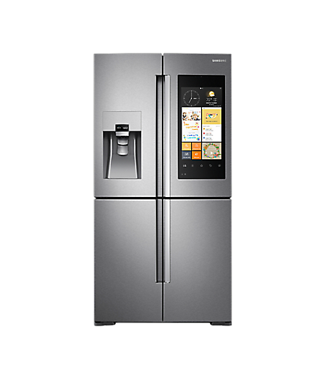
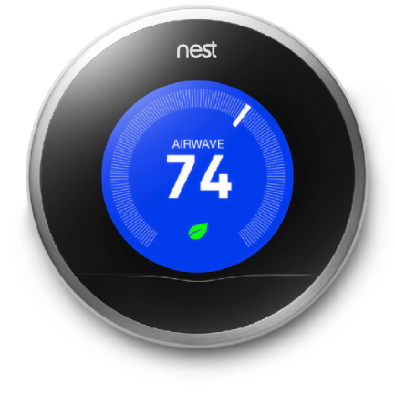



Extract
Credentials
Extract
Intellectual
Property
Tamper to
Cause Harm
Notes:
Since they are typically under the control of their owners, IoT devices are vulnerable to these sort of attacks.
They are susceptible to many of the same attacks we’ve seen already
someone might want to extract intellectual property embedded within these devices,
or someone may want to tamper with them to cause harm, in this case a medical device.
or since these devices often have credentials embedded in their firmware, someone might want to reverse engineer and get hold of these credentials.

Slide 22




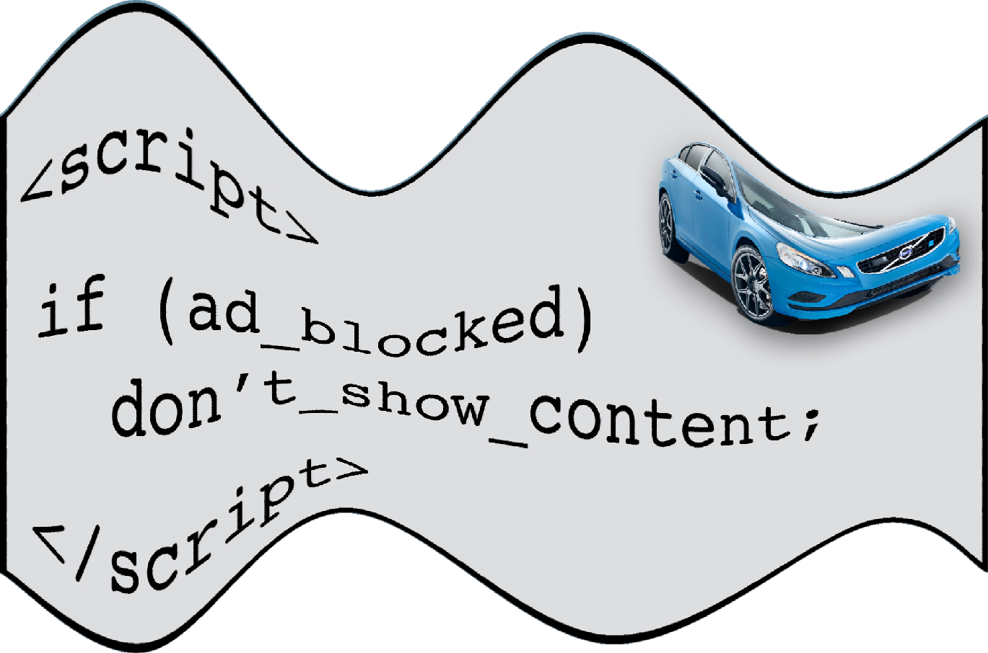


nytimes.com
nytimes.com
<script>
if (ad_blocked)
don’t_show_content;
</script>
Extensions
Extensions
if (has_pattern(
if (blacklisted)
don’t_show_ad;
“if (ad_blocked)
don’t_show_content;”
))
don’t_show_ad;
Notes:
And finally, here’s a scenario where Alice is reading the New York Times. The NYT is evil enough to want revenue, and so places ads on their page. Alice would rather not have to read these ads,
installs an ad blocker, and this ad blocker notices when an ad appears on a page, and removes it.
The NYT then delivers scripts along with their ads that detect if the ad is being blocked, in which case they don’t show the content.
Then Alice updates her ad blocker to look for the pattern of the NYT’s code, and the ad is blocked.
The NYT then obfuscates their Javascript code so that Alice’s ad blocker can no longer recognize it.
So, it appears that, instead of going away, these type of scenarios are, in stead, becoming more and more common.

Slide 23
Performance Matters
Metric | Program | Slowdown
absolute time | application | <1s
relative | application | 1.5x
relative | security kernel | 100x-1000x
Code virtualizer | ExeCryptor | VMProtect | Themida
100x | 700x | 500x | 1200x
Liem, Gu, Johnson: A compiler-based infrastructure for software-protection, PLAS’08
Notes:
So, “performance matters”, both for Alice and Bob.
To get some idea of what this means for Alice, I asked a few industry contacts and I got a couple of anecdotal data points:
One media distribution company said “user experience may not be harmed”; in other words, everything must run in less than a second.
A second company writes that for one particular customer, their acceptance criteria was 150% of original size and runtime.
The final company recommends a slowdown of 100­-1000, but for a security kernel, not the entire application.
We also measured some common commercial obfuscators, and got slowdowns in the range from 100 to 1200.

Slide 24
Time-to-Crack Matters
Analysis | Program | Performance
Concolic | 14 lines | 4 hours
Dynamic/ Symbolic | Tigress Challenge 3.4 | 2.2 hours, 170GB RAM
Salwan, et. al, Playing with Binary Analysis, SSTIC’07
Notes:
For Bob, Time-to-Crack matters.
Here are some examples from the literature.
You can see that, even for very small programs, an analysis can take several hours, and use up gigabytes of memory.

Slide 25

ssergiT
Tigress
Design
ngiseD
Notes:
One problem we’ve had in the academic community is that there were no comprehensive obfuscators available to play with; to remedy this I built the Tigress tool.
And today I will be talking about the design of Tigress and some of the obfuscating transformations it contains.

Slide 26
Obfuscation Script
Encode
Arithmetic
NEXTINSTR[VPC]
Flatten
Virtualize
Functions=foo
Functions=foo
Functions=bar
Option=…
Option=…
Option=…
Option=…
Option=…
Option=…
P.c
P’.c
Seed
Notes:
Tigress is, more or less, a source to source transformer - it takes C source in and produces C source out.
It also takes a seed as input, which allows us to generate multiple obfuscated versions from the same input program - in other words, we can use it for diversification.
Finally, Tigress takes an obfuscation script as input.
Tigress is function oriented, so this script lists the
functions you want to obfuscate,
the transformations you want to perform on these functions,
and a set of options for these transformations.
And there are lots and lots of options, allowing you to select different variants of the transformations.

Slide 27
Transformations
Anti Taint
Analysis
NEXTINSTR[VPC]
Opaque
Predicates
Flatten
Virtualize
Merge
Dynamic
Split
Jitting
OCaml
Encode
Literals
Branch
Functions
Encode
Arithmetic
Encode
Data
Tigress Infrastructure
CIL
myJit
Notes:
The Tigress tool is built on four distinct pieces:
CIL, which is a tool from Berkeley that reads and normalizes C code
The Tigress infrastructure that provides a number of primitives that many transformations rely on
The transformations themselves, which are built on top of this infrastructure.
Some transformations can only be performed on binary code, not source, and for that purpose we have a built-in jitter called myJit.
Tigress is written entirely in OCaml, about 80,000 lines in all.

Slide 28
foo()
Canonicalized C
loop
Alias
Analysis
Data Flow
Analysis
if
int
set
gcc
MSVC
Type
Analysis
flt
flt
var
binop
CIL
Notes:
CIL eats C source, both the gcc variant and Microsoft C.
It builds up what amounts to an AST, and in the process of doing so, compiles out many of the ugly warts of C, leaving something much more palatable to work with.
CIL also does a complete type analysis,
And it provides a number of tools such as alias analysis and a data flow analysis framework.

Slide 29
CIL: Canonicalized C AST
gcc/
MSVC
loop
if
P.c
P’.c
CIL
set
int
var
flt
binop
Type
Analysis
Alias
Analysis
Data Flow
Analysis
Notes:
CIL eats C source, both the gcc variant and Microsoft C.
It builds up what amounts to an AST, and in the process of doing so, compiles out many of the ugly warts of C, leaving something much more palatable to work with.
CIL also does a complete type analysis. This means that, yes, Tigress is source-to-source, but it’s not simply textual transformations, we have complete type information to perform any transformation we want.
And CIL provides a number of tools such as alias analysis and a data flow analysis framework.

Slide 30
Tigress Infrastructure
loop
if
set
var
binop
Crypto
Opaque
Dynamic
Implicit
Flow
Entropy
Notes:
On top of CIL, Tigress provides several internal representations, such as a low level tree representation, a linear representation, and a CFG representation.
There are transformers that will convert back and forth between these representations.
This allows you to pick the most convenient representation to implement a particular transformation.
Tigress also provides a large number of libraries that simplify building a particular transformation.
For example, there’s a crypto library, a library to generate entropy at runtime, etc.

Slide 31
Tigress Transformations
loop
Flatten
if
set
loop
var
binop
if
set
var
binop
Notes:
The main part of Tigress, of course, are the transformations.
All of them start out with an AST, you convert it to whatever form you want to work on, such as an CFG in this case, perform the transformation, and then convert back to the AST.
In other words, all transformations are, essentially source-to-source. This greatly simplifies debugging of the transformations since you can easily look at the resulting C code after each step,

Slide 32



Binary Transformations
loop
JIT
push rbx
lea rdi,[…]
call puts
if
set
loop
var
binop
if
set
var
binop
Dynamic
Notes:
Some obfuscating transformations cannot easily be done source-to-source; they are designed to only be performed on binary code.
For that purpose we have a built-in jitter called myJit.
myJit can do run-time code generation for x86, SPARC, and ARM, which gives us binary code that we can then transform.
So, again,
you start out with the AST,
use myJit to convert to binary form,
apply the transformation, in this case the dynamic transformation that I will talk about in a minute.
And then, as usual, transform back to AST form, ready for the next transformation.

Slide 33
loop
if
set
var
binop
Crypto
Opaque
Dynamic
Implicit
Flow
Entropy
Tigress Infrastructure
Notes:
On top of CIL, Tigress provides several internal representations, such as a low level tree representation, and a CFG representation.
There are transformers that will convert back and forth between these representations.
This allows you to pick the most convenient representation to implement a particular transformation.
Tigress also provides a large number of libraries that simplify building a particular transformation.
For example, there’s a crypto library, a library to generate entropy at runtime, etc.

Slide 34
loop
loop
if
if
set
set
var
binop
var
binop
Transformations
Anti Taint
Analysis
NEXTINSTR[VPC]
Opaque
Predicates
Flatten
Virtualize
Notes:
The main part of Tigress, of course, are the transformations.
All of them start out with an AST, you convert it to whatever form you want to work on, such as an CFG in this case, perform the transformation, and then convert back to the AST.
In other words, all transformations are, essentially source-to-source. This greatly simplifies debugging of the transformations since you can easily look at the resulting C code after each step,

Slide 35
loop
loop
if
if
set
set
var
binop
var
binop
Transformations
Anti Taint
Analysis
NEXTINSTR[VPC]
Opaque
Predicates
Flatten
Virtualize
Notes:
The main part of Tigress, of course, are the transformations.
All of them start out with an AST, you convert it to whatever form you want to work on, such as an CFG in this case, perform the transformation, and then convert back to the AST.
In other words, all transformations are, essentially source-to-source. This greatly simplifies debugging of the transformations since you can easily look at the resulting C code after each step,

Slide 36
loop
myJit
if
push rbx
lea rdi,[…]
call puts
set
var
binop
loop
if
set
var
binop
Dynamic
Notes:
Some obfuscating transformations cannot easily be done source-to-source; they are designed to only be performed on binary code.
For that purpose we have a built-in jitter called myJit.
So, myJit can do run-time code generation for x86, SPARC, and ARM, which gives us binary code that we can then transform using the dynamic transformation that I will talk about in a minute.
And then, as usual, we transform back to AST form, ready for the next transformation.

Slide 37
foo = compile(
“r1 = r1 + r2”,
“cmp r1, 42”,
“bra L1”
);
(*foo)();
myJit
Notes:
Some obfuscating transformations cannot easily be done source-to-source; they are designed to only be performed on binary code.
For that purpose we have a built-in jitter called myJit.
From a very simple RISC-like language, myJit can do run-time code generation for x86, SPARC, and ARM
This allows us to play all kinds of cool obfuscation tricks that involve transformations on machine code.

Slide 38
Merge
M2.c
P.c
M1.c
M1.c
M2.c
M3.c
M3.c
Notes:
Let’s start by looking at virtualization - a very common transformation in both free and commercial tools.
Here, I’m going to focus on an obfuscation tool called Tigress, which you can download and play with for free.
To virtualize a particular function P which has some asset,
you start by creating a unique and random virtual instruction set specific to this function;
Next, you translate the original program P into the virtual instruction set that you just created. We’ll call this the bytecode array;
Finally, you construct an interpreter that can execute programs written in this random instruction set;
This interpreter consists of
an execution stack,
a dispatch unit which issues the next instruction, and
one instruction handler per virtual instruction.
So, essentially what we’re doing here is to convert the original code into random data, and then provide a way to execute this data.
This is similar to a Java interpreter, for example, except that each function you obfuscate will have a unique and random virtual instruction set, unknown to the adversary.

Slide 39
Remainder of This Talk
Generic
De-obfuscation
a←b;
NEXTINSTR[VPC]
Dynamic
Virtualize
Anti-Taint
P.c
P’.c
Notes:
In the remainder of this talk we will talk about 2 Tigress transformations: dynamic obfuscation and virtualization.
Then we will look at an attack against these transformations, generic de-obfuscation.
And then, finally, we’ll look at a novel way to attack generic de-obfuscation, namely anti-taint analysis.

Slide 40
Dynamic
Generic
cireneG
cimanyD
Dynamic
notiacsufbO
Obfuscation
Notes:
Ok, so let’s look at dynamic transformations as they are implemented in Tigress.

Slide 41
P’(){
}
P(){
}
Self-Modifying Code!
Code in Constant Flux!
Code Never Fully in the Clear!
Notes:
What’s a dynamic obfuscation?
Well, the idea is to use self-modifying code, to ensure that
The code keeps changing as the program is executing
And that at no time should the entire code exist in cleartext

Slide 42

DECODE( )
DECODE( )
ENCODE( )
DECODE( )
Notes:
Many dynamic obfuscation algorithms are based on the same idea:
decode a piece of the code right before you need it, and then
encode it again once you’re done with it.
In this example we have a function which is shown as a control flow graph. The pink block is in cleartext, the rest of the blocks are encoded in some way.
The pink code wants to continue executing at the blue block, the yellow block, and then the green block. But, before it can do that, it has to decode these blocks.
So, decode the blue code, and then jump to it;
Then the blue code decodes the yellow block, jumps to it;
and then the yellow code re-encodes the blue block,
And the the yellow code decodes the green block, and jumps to it,
and so on.

Slide 43
Code is
self-modifying!
always changing!
never fully clear!
DEC( )
xxxxxxxxxxxxxxxxxxx
xxxxxxxxxxxxxxxxxxx
xxxxxxxxxxxxxxxxxxx
xxxxxxxxxxxxxxxxxxx
xxxxxxxxxxxxxxxxxxx xxxxxxxxxxxxxxxxxxx
xxxxxxxxxxxxxxxxxxx
xxxxxxxxxxxxxxxxxxx
xxxxxxxxxxxxxxxxxxx
xxxxxxxxxxxxxxxxxxx
xxxxxxxxxxxxxxxxxxx xxxxxxxxxxxxxxxxxxx
xxxxxxxxxxxxxxxxxxx
xxxxxxxxxxxxxxxxxxx
xxxxxxxxxxxxxxxxxxx
xxxxxxxxxxxxxxxxxxx
xxxxxxxxxxxxxxxxxxx xxxxxxxxxxxxxxxxxxx
DEC( )
DEC( )
xxxxxxxxxxxxxxxxxxx
xxxxxxxxxxxxxxxxxxx
xxxxxxxxxxxxxxxxxxx
xxxxxxxxxxxxxxxxxxx
xxxxxxxxxxxxxxxxxxx xxxxxxxxxxxxxxxxxxx
ENC( )
DEC( )
xxxxxxxxxxxxxxxxxxx
xxxxxxxxxxxxxxxxxxx
xxxxxxxxxxxxxxxxxxx
xxxxxxxxxxxxxxxxxxx
xxxxxxxxxxxxxxxxxxx xxxxxxxxxxxxxxxxxxx
xxxxxxxxxxxxxxxxxxx
xxxxxxxxxxxxxxxxxxx
xxxxxxxxxxxxxxxxxxx
xxxxxxxxxxxxxxxxxxx
xxxxxxxxxxxxxxxxxxx xxxxxxxxxxxxxxxxxxx
Notes:
Many dynamic obfuscation algorithms are based on the same idea:
decode a piece of the code right before you need it, and then
encode it again once you’re done with it.
In this example we have a function which is shown as a control flow graph. The pink block is in cleartext, the rest of the blocks are encoded in some way.
The pink code wants to continue executing at the blue code.
But, before it can do that, it has to decode the blue code, and then it can jump to it;
Then the blue code decodes the yellow code, jumps to it;
and then the yellow code first re-encodes the blue code,
And the the yellow code decodes the green code, and jumps to it,
and so on.

Slide 44
PLUG_HOLE()
MAKE_HOLE()
Kanzaki et al., Exploiting Self-Modification Mechanism for Program Protection
Notes:
There are many variants of this idea that have been proposed in the literature.
Here’s one where the yellow target block
has a hole in it that gets filled by the decoder at runtime,
and then the hole gets taken out by the encoder once the block has been executed.

Slide 45
FILL_HOLE()
MAKE_HOLE()
Kanzaki et al., Exploiting Self-Modification Mechanism for Program Protection
Notes:
Many dynamic obfuscation algorithms are based on the same idea:
decode a piece of the code right before you need it, and then
encode it again once you’re done with it.
In this example we have a function which is shown as a control flow graph. The pink block is in cleartext, the rest of the blocks are encoded in some way.
The pink code wants to continue executing at the blue code.
But, before it can do that, it has to decode the blue code, and then it can jump to it;
Then the blue code decodes the yellow code, jumps to it;
and then the yellow code first re-encodes the blue code,
And the the yellow code decodes the green code, and jumps to it,
and so on.

Slide 46
←
⨂
Aucsmith, Tamper Resistant Software: An Implementation, IH’96
Notes:
And here’s another idea, where the target block is xor:ed with another block.
So, the blue block will xor the encoded block with the pink block,
The yellow block will appear, and we can jump to it.

Slide 47
←D ( )
Cappaert, Preneel, et al. Towards Tamper Resistant Code Encryption P&E, ISPEC'08
Notes:
And here’s another variant where the target block is encrypted using another block as the key.
So, again, before the blue block can jump to the yellow block, it decrypts it using the pink block as key,
and we can jump to the decrypted block.

Slide 48
←PATCH()
←PATCH()
Madou, et al., Software protection through dynamic code mutation, WISA’05
Notes:
This variant is a little different. Here, the yellow and green blocks are merged so that they occupy the same location at runtime.
During execution, the merged block gets patched to make it either the original yellow or green block.
So, before the blue block can jump to the yellow block, it patches it, and the yellow block appears.
Or, if we take the other path, the brown block will patch the gray block to make the green block appear.
This transformation is useful against analyses that assume that the same address always contains the same code.

Slide 49



Three Little Languages
How to ENCODE/DECODE?
Block to encode
Where to ENCODE/DECODE?
How to modify CFG?
❮target,codec,location,transform❯
Notes:
If you squint at these 4 transformations, you realize that they are really variants of the same simple idea.
In Tigress, we’ve built a system we call Generic Dynamic Obfuscation that describes a dynamic transformation as a 4-tuple:
The target block to be encoded;
The codec that describes how the target block gets decoded and re-encoded at runtime;
The location where the coder and decoder should reside;
And, finally, how the CFG should be transformed to ensure that the obfuscation is semantics preserving.
Each of these is described as a little language.

Slide 50
Three Little Languages
Codecs: How to ENCODE/DECODE?
DECODE( )
Path Expressions: Where to ENCODE/DECODE?
CFG Transformers: How to Modify CFG?
Notes:
Many dynamic obfuscation algorithms are based on the same idea:
decode a piece of the code right before you need it, and then
encode it again once you’re done with it.
In this example we have a function which is shown as a control flow graph. The pink block is in cleartext, the rest of the blocks are encoded in some way.
The pink code wants to continue executing at the blue code.
But, before it can do that, it has to decode the blue code, and then it can jump to it;
Then the blue code decodes the yellow code, jumps to it;
and then the yellow code first re-encodes the blue code,
And the the yellow code decodes the green code, and jumps to it,
and so on.

Slide 51
❮target,codec,location,transform❯
saved
encode(offset) : [
saved ← [offset];
[offset] ← rnd();
]
DECODE()
ENCODE()
Notes:
The codecs can be very simple, as in this case, where an encoder simply makes a hole in a block, and fills it in with random data.
For other dynamic transformations, the codecs can be much more complicated, of course.

Slide 52
❮target,codec,location,transform❯
saved
encode(target,offset) : [
saved ← block[target][offset];
block[target][offset] ← rnd();
]
DECODE()
ENCODE()
Notes:
The codecs can be very simple, as in this case, where an encoder simply makes a hole in a block, and fills it in with random data.
For other dynamic transformations, the codecs can be much more complicated, of course.

Slide 53
DECODE( )
ENCODE( )
DECODE( )
DECODE( )
ENCODE( )
DECODE( )
ENCODE( )
ENCODE( )
Notes:
But, where in the CFG should these codecs be inserted?
Here, the red block is the target which needs to be encoded and decoded.
We could decode and encode at the entry and exit of the CFG, but that would leave the red block in cleartext for a long time.
Or we could encode and decode right before and after the red block gets executed, but would incur higher overhead.
Or, we could encode and decode at the beginning and end of the loop.
These are all legal locations in which to place the codecs.
However, this one is an illegal placement, since there exist a path on which a block would be decoded twice.

Slide 54
D
E
{( , )|dom( )×pDom( )}→
D
D
D
E
filter( )→
E
D
filter( )→
E
D
filter( )→
D
E
E
E
filter( )
Notes:
Many dynamic obfuscation algorithms are based on the same idea:
decode a piece of the code right before you need it, and then
encode it again once you’re done with it.
In this example we have a function which is shown as a control flow graph. The pink block is in cleartext, the rest of the blocks are encoded in some way.
The pink code wants to continue executing at the blue code.
But, before it can do that, it has to decode the blue code, and then it can jump to it;
Then the blue code decodes the yellow code, jumps to it;
and then the yellow code first re-encodes the blue code,
And the the yellow code decodes the green code, and jumps to it,
and so on.

Slide 55
❮target,codec,location,transform❯
D
D
E
{( , )|dom( )×pDom( )}→
. . .
D
E
filter( )→
. . .
E
Notes:
Depending on the type of dynamic transformations, there are different restrictions on the placement of decoders and encoders.
We describe these restrictions in a second little language.
Here’s an example:
We start with a set of pairs of possible decoders and encoders, constructed by computing the dominators and postdominators of the red target block.
We then give a sequence of filters which filter out illegal decoder/encoder pairs.
This rule, for example, says that any path from the entry node to the encoder node must have exactly one decoder on it - otherwise we might try to encode a block that is already encoded.

Slide 56
❮target,codec,location,transform❯
D
D
D
E
{( , )|dom( )×pDom( )}→
D
E
filter( )→
E
D
filter( )→
. . .
E
E
Notes:
Depending on the type of dynamic transformations, there are different restrictions on the placement of decoders and encoders.
We describe these restrictions in a second little language.
Here’s an example:
We start with a set of pairs of possible decoders and encoders, constructed by computing the dominators and postdominators of the red target block.
We then give a sequence of filters which filter out illegal decoder/encoder pairs.
This first rule, for example, says that any path from the entry node to the encoder node must have exactly one decoder on it - otherwise we might try to encode a block that is already encoded.
The second rule similarly states that on any path from a decoder to the exit node there must be exactly one encoder - otherwise we would exit the function in a situation where the red target node would be in cleartext.

Slide 57

❮target,codec,location,transform❯
merge( , )
Notes:
Finally, we may have to transform the CFG to make sure that semantics is maintained.
In some cases, the transformation is trivial, but in some cases it is not.
Consider this dynamic obfuscation where the we want to merge the pink and yellow blocks into the same memory location
At runtime, either the pink or the yellow block will appear.
Just merging the blocks like this will clearly result in an illegal CFG.

Slide 58
insert(DEC( ))
insert(DEC( ))
DEC( )
DEC( )
Notes:
So, we need a 3rd little language to describe the necessary graph transformations:
First we need to insert the two decoders, one that make the pink block to appear, one to make the yellow block appear;

Slide 59
insert(DEC( ))
insert(DEC( ))
DEC( )
DEC( )
pad( , )
merge( , )
Notes:
Then, we must pad the yellow and pink block to make them the same size,
And merge them;

Slide 60
insert(DEC( ))
insert(DEC( ))
DEC( )
DEC( )
pad( , )
next←
next←
merge( , )
goto *next
insert(next← )
insert(next← )
insert(goto *next)
Notes:
And finally, we need to insert code to ensure that we jump to the right block once we are done with the merged block.

Slide 61
❮target,codec,location,transform❯
{( , )|…}→
insert(DEC( ))
encode: [
block[t][o]←rnd();
]
decode:[
block[t][o]←0x42;
]
filter( )→
insert(DEC( ))
merge( , )
filter( )→
insert(n← )
filter( )→
insert(goto* n)
filter( )
insert(n← )
Notes:
So, as you’ve seen, given these 3 little languages, (one for the codecs, one for the legal locations of codecs, and one for how to transform the control flow graph) we can describe a whole collection of dynamic transformations that have previously been described in different publications in the literature.
And this is how we approach the Tigress design: make every transformation as general as possible so that it is easy to add new variants.
And, as much as possible, merge different transformations that have been proposed in the literature into one implementation.

Slide 62
NEXTINSTR[VPC]
Virtualize
Generic
cireneG
noitazilautriV
Virtualization
Notes:
Now, let’s do the same thing with virtualization.

Slide 63
Tigress
P(){
}
P(){
}
SP
ADD
BRA
SHL
DIV
PRINT
STACK:
VPC
Bytecode
Virtual Instruction Set
add | store L | call | breq M
Opcode | Mnemonic | Semantics
0 | add | push(pop()+pop())
1 | store L | Mem[L]=pop()
2 | breq L | if pop()=pop() goto L
DISPATCH
HANDLER
Notes:
Virtualization is a very common transformation in both free and commercial tools.
To virtualize a particular function P,
you start by creating a unique and random virtual instruction set specific to this function;
Next, you translate the original program P into the virtual instruction set that you just created. We’ll call this the bytecode array;
Finally, you construct an interpreter that can execute programs written in this random instruction set;
This interpreter consists of
an execution stack,
a dispatch unit which issues the next instruction, and
one instruction handler per virtual instruction.
So, essentially what we’re doing here is to convert the original code into random data, and then provide a way to execute this data.

Slide 64
NEXTINSTR[VPC]
x:
x:
42
99
add:{
push(pop()+pop());
VPC++;
}
STACK
STACK
STACK
store:{
Mem[L]=pop();
VPC+=2;
}
SP
22
VPC
VPC
VPC
SP
20
add | store | &x | …
42
SP
Notes:
This is similar to a Java interpreter, for example, except that each function you obfuscate will have a unique and random virtual instruction set, unknown to the adversary.
At runtime, we execute a virtual program much as a Java interpreter would:
The dispatcher fetches the next instruction from the program array,
we jump to the appropriate handler,
the handler then executes the instruction,
we increment the virtual program counter,
and then we jump back to the top of this loop,
and continue until the program has finished executing.

Slide 65




Generic Virtualization
Multiple dispatch
techniques
Arbitrarily complex instruction set
Mix VM and
real code
❮target,ISA,dispatch,dynamic,stealth❯
Self-Modifying VM Code!
VM Code in Constant Flux!
VM Code Never Fully in the Clear!
Notes:
Virtualization in Tigress can be described as a 5-tuple:
The ISA is the generated random virtual instruction set;
Dispatch is the way in which the bytecode is parsed and executed at runtime;
Dynamic is, as we shall see, similar to the dynamic transformation, but applied to the bytecode;
Stealth, finally, is ways to mix bytecode execution with the execution of “normal”, binary, code.

Slide 66
❮ISA,dispatch,dynamic,stealth❯
c ← add a b
d ← add_add a b c
d ← add_sub a b c
breq_add_add a b c d
c ← sub a b
Superoperators
breq a b
Random Operands
d/stack ← add_sub_1 a/stack b/stack c/stack
d/reg ← add_sub_2 a/reg b/reg c/reg
d/reg ← add_sub_3 a/stack b/reg c/stack
Random
Opcodes
Opcode | Mnemonic | Semantics
42 | add_sub_1 | (a-b)+c
96 | add_sub_2 | (a-b)+c
252 | breq_add_add | breq (a+b+c) L
Proebsting, Optimizing an ANSI C interpreter with superoperators, POPL’95
Notes:
How can we generate a random instruction set?
Most virtualizing obfuscators have one or a few simple hard-wired instruction sets.
But in Tigress we can generate almost arbitrarily complex virtual ISAs:
We start with a very simple, RISC-like, instruction set.
Then we use a technique known as superoperators, to create new instructions that merge the semantics from multiple simple instructions.
Most virtualizing obfuscators provide either stack based or register based generated ISAs. In Tigress, however, any instruction can take any of its arguments either from the stack or from a register, and put its result on the stack or in a register.
Finally, we can randomize the opcode numbers.
The result is a virtual instruction set which is different and random for each generated interpreter.

Slide 67
❮ISA,dispatch,dynamic,stealth❯
switch
switch(prog[pc]){
…
}
direct
goto *prog[pc];
call
indirect
call *prog[pc]();
goto *jtab[prog[pc]];
Notes:
Tigress has 8 different ways to implement the dispatcher.
Many of these are well known from the interpreter literature:
switch and call threading are the most well known, probably,
but direct threading and indirect threaded code tend to be faster

Slide 68
❮ISA,dispatch,dynamic,stealth❯
P(){
}
ADD
BRA
SHL
DIV
PRINT
VPC
DECODE() | add | call | breq | ENCODE() | sub | mul
SP
Notes:
Finally, the generic dynamic obfuscation we saw earlier can be applied to virtual instruction sets also.
In other words, the 3 little languages we used to generate self-modifying binary code, can be used to make self-modifying virtual code as well!
And you can see that here, the bytecode includes instructions to decode and encode virtual instructions at runtime.

Slide 69
P(){
}
Obfuscation Script
VPC
Virtualize/Dynamic
Dynamic
DECODE() | add | ENCODE() | sub
P(){
}
DECODE
ENCODE
Notes:
Now, of course, you can compose transformations in Tigress.
First you can make the virtual bytecode dynamically changing,
and then you can apply the dynamic transformation, to make the interpreter changing.
We then get an obfuscated program where
the binary code of the interpreter is dynamically changing as we execute the program,
and the virtual bytecode is changing at the same time!
And, keep in mind, that the same little languages are used in both cases.

Slide 70



❮ISA,dispatch,dynamic,reentrance❯
Dynamic Stealth
Trace
void VM(){
}
P
Real
work
void main(){
real_work;
start VM();
real_work;
resume VM;
real_work;
finish VM;
}
Real
work
Real
work
Notes:
So, in this case, the stealth of the transformation is important. One way to increase stealth of an interpreter is to mix interpreter code with normal code.
For virtualization, it turns out that it’s easy to generate a interpreter that can be stopped and restarted.
The Tigress virtualizer can generate such an interpreter.
This way, if you’re a piece of malware you can intermix the instructions from your interpreter with the “real” instructions from the program in which you’re embedded.
This way, you have improved your dynamic stealth.

Slide 71
P(){
}
cireneG
Generic
noitacsufboeD
Deobfuscation
Notes:
So, I have a colleague 3 doors down the hall from me, Saumya Debray, who works on de-obfuscation.
And we have this friendly rivalry going on where I build obfuscation algorithms, and he breaks them…
Let’s look at an idea of his known as generic deobfuscation which is a successful attack against virtualization and dynamic obfuscation.

Slide 72
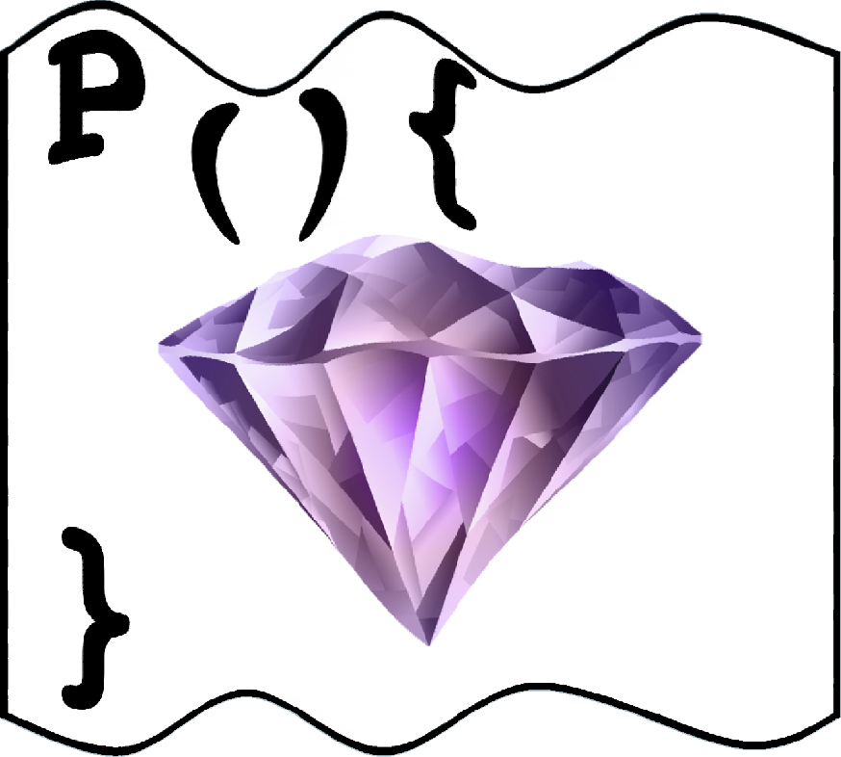
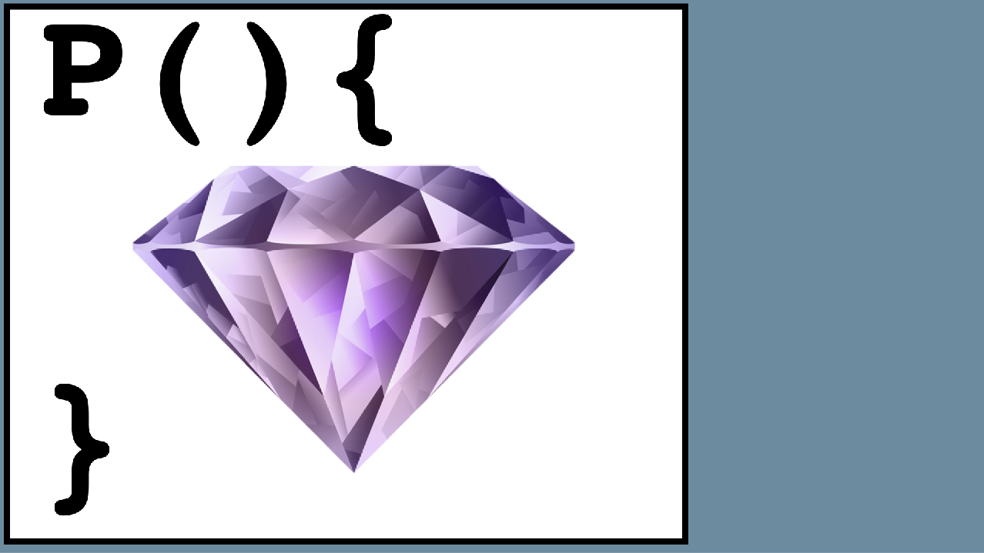
Dynamic Analysis
INPUT
TRACE
ADD
SUB
BRA
SHL
CALL
DIV
XOR
TRACE’
ADD
BRA
DIV
XOR
PUSH()
POP()
P(){
}
OUTPUT
Yadegari, et al., A Generic Approach to Deobfuscation. IEEE S&P’15
Notes:
The idea is to think of a program as a pure function, it takes some input, the program traces a path through the code, and then produces some output.
When we obfuscate the program it does the same thing, only there are extra computations that didn’t really contribute to transforming the input to the output.
So, we’ll do the following:
We’ll take a complete trace of the program, as it is executing on a particular input. The pink instructions are the ones the obfuscation inserted: the dispatch in an interpreter, the decode instructions in the dynamic obfuscation we just saw.
Now we get rid of these extra pink instructions and we have a trace that only consists of instructions from the original, unobfuscated, program.
Using some advanced magic, we then fold this trace back into the original source.

Slide 73
Forward
Taint Analysis
(depend on input)
Compiler
Optimizations
Backward
Taint Analysis
(contribute to
output)
main (a) {
main () {
b←a;
b←a;
ADD
SUB
BRA
SHL
CALL
DIV
XOR
ADD | ✓
SUB
BRA | ✓
SHL | ✓
CALL
DIV
XOR
ADD | ✓
SUB
BRA | ✓
SHL | ✓
CALL
DIV | ✓
XOR | ✓
ADD
BRA
SHL
DIV
XOR
ADD | ✓
SUB
BRA | ✓
SHL | ✓
CALL
DIV | ✓
XOR | ✓
ADD
BRA
DIV
XOR
printf(b);
c←b;
}
}
Notes:
In order to make this work we need an accurate taint-analysis.
We start by taking a complete trace of the program, for a particular input.
Then we do a forward sweep over the trace, and mark all the instructions that depend on input.
This is called a forward taint analysis. All we’re doing, is following the flow of information from the inputs, to see what is input dependent.
Then, we do a backwards sweep over the trace, and mark all the instructions that contributed to the output.
This is called a backward taint analysis. Here we are following the flow of information from the outputs, back to any computation that contributed to this output.
Next, we remove any instructions that were not marked since they are probably the result of obfuscation.
Then, we run a compiler optimization pass over the trace, and
Finally we re-flow the trace back into source code.

Slide 74
Not input
dependent!
P(){
}
SP
ADD
BRA
SHL
DIV
PRINT
STACK:
ADD
SUB
BRA
SHL
CALL
DIV
PRINT
ADD | ✓
SUB
BRA | ✓
SHL | ✓
CALL
DIV | ✓
PRINT | ✓
ADD
BRA
DIV
PRINT
VPC
DECODE()
sub | add | call | print
P(){
}
ENCODE()
Notes:
So, let’s apply this idea to virtualized code.
Here’s an interpreter with the VPC, the bytecode array, the dispatch unit, the handlers, the stack - all the stuff we’ve seen before.
Now, if you think about it, the VPC and the byte code array, the stack - none of them depend on input.
So, when we do our taint analysis, none of the instructions that originated with the virtualization obfuscation will be tainted.
And, we will be able to deobfuscate them away, and get back to a close approximation of the original code.
And this works on dynamic code as well, since the decoders and encoders are not input dependent.

Slide 75

SUB
BRA
SHL
CALL
DIV
LEA
BLE
SLA
BRA
TEST
LEA
JREG
XOR
JMP
SUB
FDIV
CALL
LEA
MUL
JMP
BLE
SRL
CALL
BOR
STO
BRA
AND
CALL
SUB
FADD
CALL
JMP
TEST
LEA
BLE
ADD
SUB
BAND
FADD
BRLE
FDIV
JREG
SUB
BRLE
SRA
FADD
LD
STO
FSUB
CALL
BRA
LD
SEXT
CALL
BOR
JMP
SUB
Anti-Dynamic Analysis
Artificially inflate trace size
Force the collection of multiple traces
Prevent traces from being collected
if (traced)
abort();
main(){
}
Pawlovski, et al., Probfuscation: An Obfuscation Approach …
Notes:
Of course, there are multiple tricks Alice can employ to make a dynamic analysis harder.
For example, she can artificially inflate trace sizes by inserting garbage instructions;
Or, she can artificially increase the number of paths in the program to force Bob to collect multiple traces;
Or, she can insert security checks that make the program fail if it is being traced.

Slide 76
a←b;
Anti-Taint
-tniaT itnA
Anti Taint-
Analysis
sisylanA
Notes:
So, what can we do about this?

Slide 77
Remainder of This Talk
Generic
De-obfuscation
a←b;
NEXTINSTR[VPC]
Dynamic
Virtualize
Anti-Taint
P.c
P’.c
Notes:
So, this leads us to the final part of the talk - how do we

Slide 78
Taint
Analysis
main () {
bit a,b;
ADD
SUB
BRA
SHL
CALL
DIV
XOR
ADD | ✓
SUB
BRA | ✓
SHL | ✓
CALL
DIV
XOR
ADD | ✓
SUB
BRA | ✓
SHL | ✓
CALL
DIV | ✓
XOR | ✓
ADD
BRA
SHL
DIV
XOR
ADD | ✓
SUB
BRA | ✓
SHL | ✓
CALL
DIV | ✓
XOR | ✓
?
←
ADD
BRA
DIV
XOR
a b;
}
Notes:
Well, to disrupt generic deobfuscation, all we have to do is make taint analysis too expensive for the adversary.
In other words, for any statement “a is assigned b”, we need to prevent the adversary from being able to tell that there is, in fact, a data flow from b to a.

Slide 79
main(){
int a←b
}
Implicit
Flow
😄
main(){
int a ← 0
}
no data
dependence!
for(i←0; i<b; i++)
a++
☹️
but control
dependence
Notes:
There have been many attempts in the past to try to hide data flow.
Here, a and b are integers, and our program copies b to a. How do we hide this fact?
Well, to copy b to a we simply let a start out being 0, and then increment a, b number of times.
There are no direct data dependencies here, but there is still a control dependence from b to a.
Many analysis engines are able to analyze such control dependencies.

Slide 80
bit value;
void handler(…) {
value ← 1
}
main(){
bit a←b
}
😄
no data
dependence!
main(){
signal(31,handler)
}
☹️
value ← 0
if (b == 1)
raise(31)
a ← value
still control
dependence
b
Notes:
Let’s try this again, but, for simplicity, a and b are bits.
Now we’re going to step things it up a bit, by using signals.
So, we
first register a signal handler, and,
if b is a 1-bit, raise a signal
the code in the handler gets executed,
and this copies the value of b to a.
Again, there are no data dependencies here, but there is still a control dependence.

Slide 81
bit value;
void handler(…) {
value ← 1
}
main(){
bit a←b
}
😄
no data
dependence!
main(){
value ← 0
signal(31,handler)
if (b == 1)
raise(31)
a ← value
}
☹️
still control
dependence
b
Notes:
Let’s try this again, but, for simplicity, a and b are bits.
Now we’re going to step things it up a bit, by using signals.
So, we
first register a signal handler, and,
if b is a 1-bit, raise a signal
the code in the handler gets executed,
and this copies the value of b to a.
Again, there are no data dependencies here, but there is still a control dependence.

Slide 82
bit value;
void handler(…) {
value ← 1
}
main(){
value ← 0
signal(31,handler)
if (b == 1)
raise(31)
a ← value
}
main(){
bit a←b
}
😄
no data
dependence!
☹️
still control
dependence
b
Notes:
Here, we’re stepping it up a bit, by using signals.
Here, and in the rest of this talk, for simplicity, a and b are bits.
We
first register a signal handler, and,
if b is a 1-bit, raise a signal
the code in the handler gets executed,
and this copies the value of b to a.
Again, there are no data dependencies here, but there is still a control dependence.

Slide 83


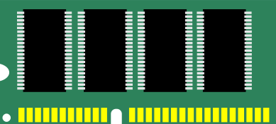
bit value;
void handler(…) {
value ← 1
}
main(){
value ← 0
signal(31,handler)
if (b == 1)
raise(31)
a ← value
}
b
signal(){
…
}
b
b
I/O
b
Notes:
But, this is still rather interesting.
If you think about it, you realize that this control dependence is actually quite complicated.
The raise function
transfers control to the operating system,
which then invokes the handler,
the handler returns, transferring control to the OS,
which then, finally, transfers control back to main().

Slide 84
}
main(){
a ← b
}
Visible State
a
b
Invisible State
Runtime clock
State of CPU caches
State of file cache
State of GC
State of JITter
libc
signal()
Program
Analysis
GC
read()
I/O
pthreads
write()
jitting
Notes:
So maybe this is an interesting observation.
In a normal program analysis, the analyzer only has to consider what we call the Visible State, that is, normal C semantics.
Maybe we can make the analyzer also consider the invisible state: the behavior of the operating system, CPU caches, file caches, garbage collectors, jitters, and so on.
So, in an obfuscated assignment, the value of b would snake its way out of the regular program semantics, through hardware, kernel, operating system, and libraries, before reaching its target.
And, ideally, the analyzer would need to understand all these layers to be able to determine that a does, indeed, depend on b.
If we could force the analyzer to consider both the visible and invisible state, maybe we could overwhelm it.

Slide 85
main(){
}
a
a ←
b
retrieve
into
visible
state
←
leak
into
invisible
state
← b
Stephens, et al., Probabilistic Obfuscation through Covert Channels, Euro S&P 2018
Notes:
So, to obfuscate “a is assigned b”, we need two functions, leak and retrieve.
First, the leak function takes the value of b and leaks it into the invisible state.
And then, the retrieve function retrieves the value back into the visible state,
and then finally assigns it to a.
Now, all we have to do is to think of as many ways as we can of leaking something into the invisible state, and retrieving it back into the visible state.

Slide 86
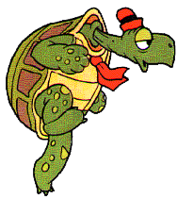

}
start ← clock()
no data or control
dependence!
😄
if (b == 1)
else
Program
Analysis
a ← (clock()-start) > 𝜹
“a depends
on clock()”
Notes:
The easiest invisible state to measure from inside a program, is time.
So, to leak the value of b, we can simply run a slow process for a 1-bit, and a fast process for a 0-bit, and to retrieve the value we simply measure the time to perform the process.
An analyzer looking at this will find neither data nor control dependence between a and b.
In fact, it will find only that a depends on the behavior of the clock() function.

Slide 87
start ← clock()
if (b == 1)
else
a ← (clock()-start) > 𝜹
for(i=0; i<n; i++);
for(i=0; i<m; i++);
Notes:
So, how do we make a fast and a slow process?
Well, the easiest thing would be to just make a fast and a slow loop, of course.

Slide 88
start ← clock()
if (b == 1)
else
a ← (clock()-start) > 𝜹
libc
signal()
GC
read()
I/O
pthreads
write()
jitting
Notes:
But that’s not what we want.
What really want is to pass information through the invisible state.
That is, we want information flow through the entire execution environment of the program.
If we can accomplish this, it will make the job of the analyzer all the more difficult.

Slide 89
start ← clock()
a ← (clock()-start) > 𝜹
buf1
buf1
buf1
for (i=0; i<n; i++)
if (b == 1)
flush ; read ; write
else
flush ; read ; write
buf1
buf2
buf2
Notes:
OK, let’s look at some actual examples.
Here, we’re making use of the fact that accessing data that’s in the cache is faster than if it’s not:
We declare 2 buffers and,
For a 1-bit we read from a buffer that’s not in the cache, and
For a 0-bit we make sure it’s in the cache.
And to retrieve the bit, we simply measure the time this operation takes.

Slide 90
if (b == 1)
open(“foo”,NOCACHE)
else
open(“foo”,CACHE)
start ← clock()
read(“foo”)
a ← (clock()-start) > 𝜹
Notes:
We can do a similar task using the file cache rather than the processor cache.
Here we read from a file that’s either being cached by the OS or not, depending on the bit we want to transfer.
And again we measure the time to retrieve the value.

Slide 91
Bytecode
baz
foo
foo
bar
if (b == 1)
;
else
foo()
Jitted
binary code
start ← clock()
foo()
a ← (clock()-start) > 𝜹
Notes:
Here, we’re making use of the JITting library that is used for many interpreted languages, such as Java.
In a JITted system,
a function first exists only in bytecode form.
and then, once it’s called a few times, it gets JIT-compiled to binary code.
So,
To leak a 1-bit we do nothing,
To leak a 0-bit we invoke foo to ensure that it gets JITted
And then we measure the time to call foo: fast if it’s been already jitted, slow otherwise.

Slide 92
GC()
if (b == 1)
list ←
else
list ←
…
start ← clock()
GC()
a ← (clock()-start) > 𝜹
Notes:
We can also use the garbage collector to leak and retrieve.
To leak we
first, perform a collection to clear the heap of any existing garbage;
then, for a 1-bit we create a long list;
And, for a 0-bit we create a short list.
And to retrieve the value, we time a second garbage collection.
For many GC algorithms a collection is slower if there are lots of live objects on the heap.

Slide 93
}
Issue #1: Pattern-Matching Attacks
start ← clock()
if (b == 1)
else
a ← (clock()-start )> 𝜹
Pattern
Analysis
☐ ← time()
if (☐)
☐
else
☐
☐ ← (time()-☐)>☐
Notes:
So there are a couple of problems with these ideas.
First of all, there may be simple pattern-matching attacks.
There are only so many ways to measure time, and we can simply embed leak and retrieve patterns in the analyzer.
This means there may not be any need for the analyzer to understand the execution environment at all.
So, we need to consider the stealth of the transformed code.

Slide 94
main(){
}
create( )
b
create( )
a←b
bit a← b
join( , )
!b
a←!b
Notes:
So somehow we need to be able to measure time without actually calling the clock() function.
Here’s one simple way to do that:
We create a thread that runs the slow code,
And we create another thread that runs the fast code.
There’s a race condition where they both write to the variable a
But the slow thread will “win” —that is, finish last — and will write the correct value.
And still, there’s no explicit timing involved.

Slide 95
Issue #2: Correctness
main(){
bit a←b
}
b
b
b
b
b
b
start ← clock()
flush
if (b == 1)
read
write
else
read
write
a ← (clock()-start) > 𝜹
Notes:
Another potential problem is correctness.
Since we’re measuring something in the environment, occasionally that measurement will go wrong.
One way to deal with this is to simply send the variable b multiple times, and take the majority result.
We use fancy statistics to figure out the number of times to send b to ensure a certain level of correctness.

Slide 96

NEXTINSTR[VPC]
Split
Merge
Virtualize
Anti
Taint
Analysis
Flatten
Jitting
Dynamic
Encode
Data
Encode
Literals
Opaque
Predicates
Encode
Arithmetic
Branch
Functions
≈
Notes:
We’ve added these, and other, anti-taint analyses to our Tigress obfuscation tool.
Tigress also has a bunch of standard obfuscating transformations, that we saw earlier, such as flattening, virtualization, dynamic obfuscations, and so on.
All these transformations make use of assignments, of course, and so we can actually strengthen them by making them use the new anti-dataflow system.

Slide 97
Hey, wait a minute, aren’t these just
side channels?
Notes:
Now, if you think this looks an awful lot like the side channels that you find exploited in many cryptographic systems, you would be correct.

Slide 98




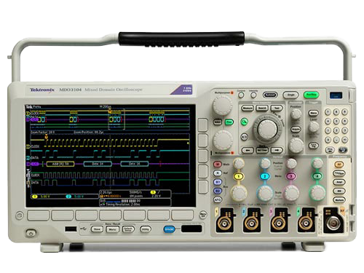

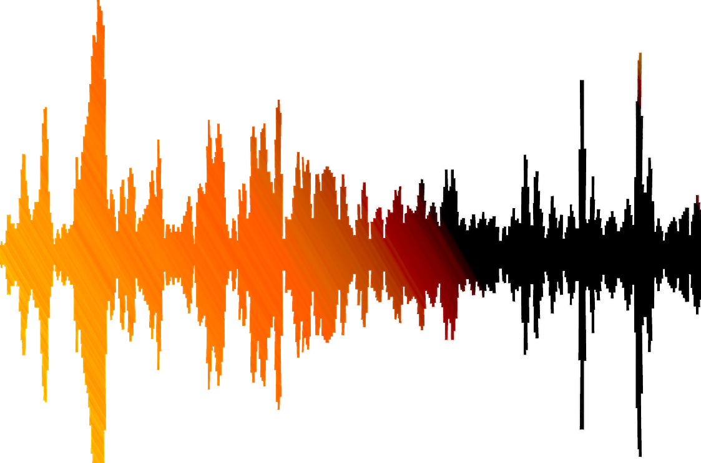
main(){
x←E(“secret”)
}
Exfiltrate!
“secret”!
Notes:
In such cases,
we measure some aspect of a system when it performs a cryptographic operation over a secret,
in order to exfiltrate that secret.
Typical aspects you could measure are
time,
radiation,
heat, and
sound.

Slide 99

main(){
a ← b
}
Notes:
What we’re doing is very similar.
The difference is that, what we’re doing is leaking and retrieving within the same system.
Indeed we’re leaking and retrieving within the same program.

Slide 100

main(){
a ← b
}
read CPU
temperature
speed up/
slow down
Notes:
So far, we’ve only talked about measuring time, because that’s easy to do within a program. There’s no reason we couldn’t measure some other aspect, of course.
Here,
To leak, we speed up or slow down the CPU depending on the value of b.
To retrieve, we measure the temperature of the CPU with the sensors on the chip.

Slide 101

main(){
a ← b
}
listen to
hard drive
speed up/
slow down
Notes:
Here,
We leak by changing the behavior of the hard drive depending on the value of b,
and retrieve using the microphone.

Slide 102
main(){
a ← b
}
flash to
screen
read from
camera
b
b
Notes:
Here,
we leak by flashing the screen depending on the value of b,
and retrieve using the camera.

Slide 103


main(){
a ← b
}
read from
microphone
play
sound
Notes:
Here,
we leak by playing a sound based on the value of b,
and retrieve using the microphone.

Slide 104

main(){
a ← b
}
Notes:
Of course, we can make this arbitrarily ridiculous and complicated.
Here
we we leak by playing an inaudible sound from a dog whistle,
your dog hears it, barks,
and we retrieve using the microphone.

Slide 105
main(){
a ← b
}
OK, maybe not
Notes:
OK, probably not a great idea…

Slide 106

ssergiT
Tigress
snoitacilppA
Applications
Notes:
So, that’s the design of Tigress, and some of the transformations that it contains.
But, what can you do with such a C-language source-to-source obfuscator?
Turns out, quite a bit!
So let’s look at how people have been using Tigress!

Slide 107
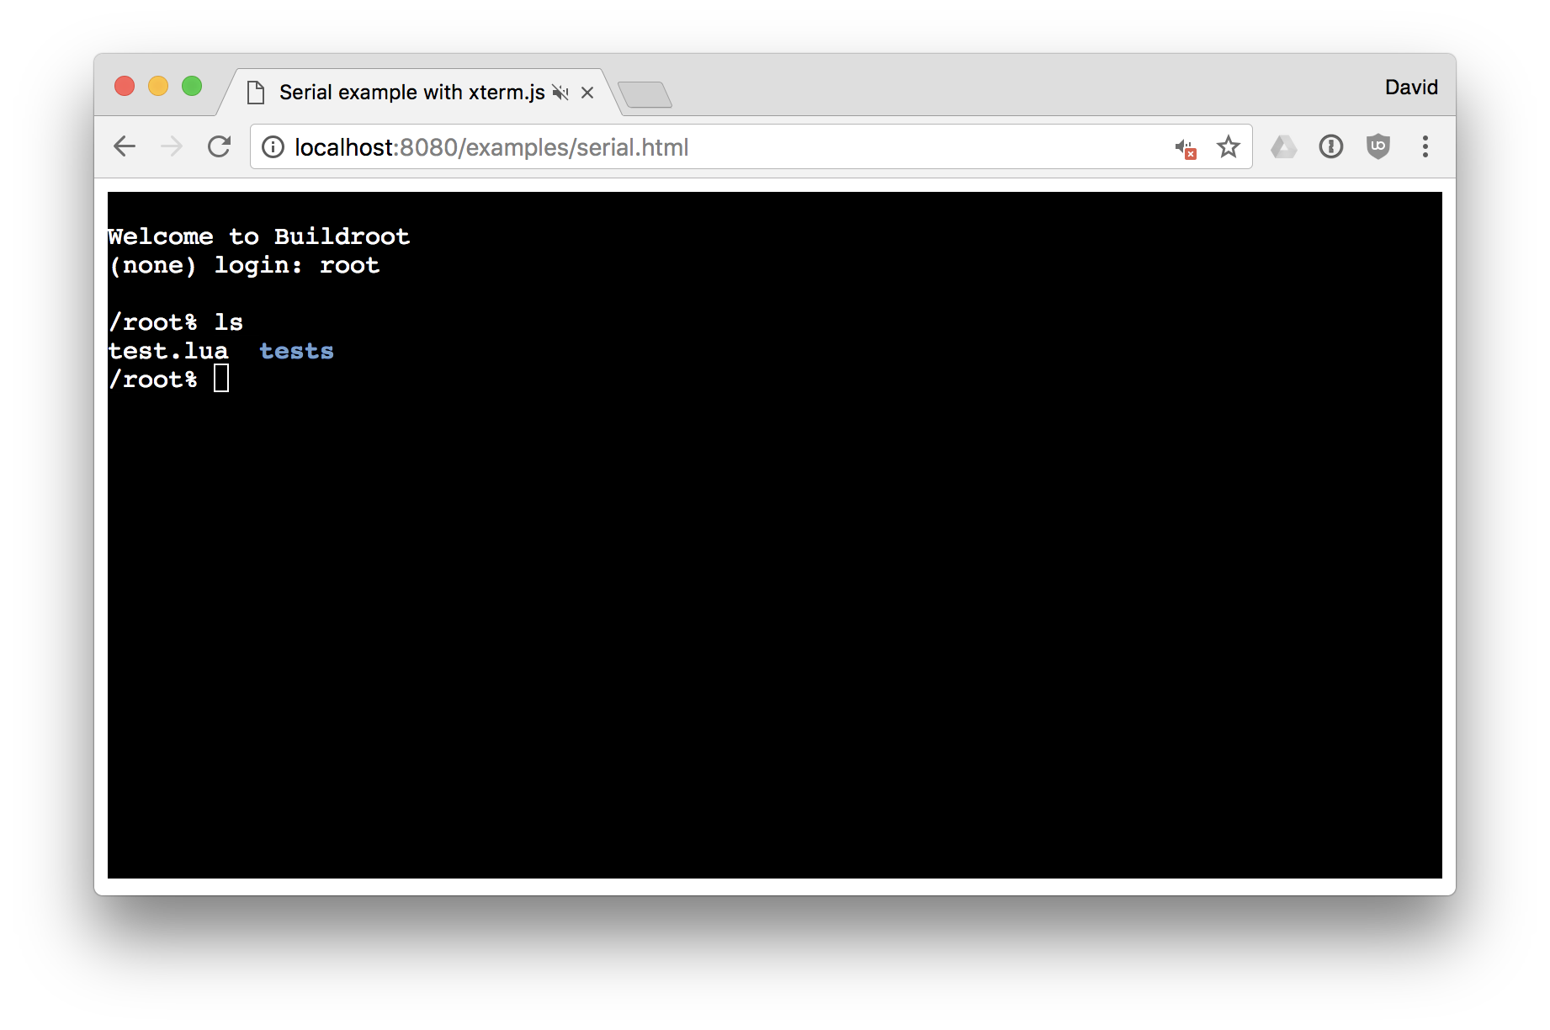
P.c
void SECRET(unsigned long i[1] , unsigned long o[1] ) {
unsigned long s[4] ;
s[0UL] = i[0UL] + 762537946UL;
s[1UL] = i[0UL] | ((16601096UL << (s[0UL] % 16UL | 1UL)) |
(16601096UL >> (64 - (s[0UL] % 16UL | 1UL))));
s[2UL] = (i[0UL] ^ 643136481UL) ^ (s[0UL] + 292656718UL);
s[3UL] = (i[0UL] << (((s[1UL] >> 4UL) & 15UL) | 1UL)) |
(i[0UL] >> (64 - (((s[1UL] >> 4UL) & 15UL) | 1UL)));
unsigned long l = 0UL;
while (l < 3UL) {
s[1UL] |= (s[2UL] & 15UL) << 3UL;
s[l + 1UL] = s[l]; l += 2UL;
}
if ((s[0UL] | s[1UL]) > (s[2UL] | s[3UL])) {
s[3UL] |= (s[1UL] & 31UL) << 3UL;
} else {
s[2UL] = s[0UL]; s[3UL] |= (s[2UL] & 15UL) << 3UL;
}
s[0UL] = s[2UL];
o[0UL] = (s[0UL] << (s[1UL] % 8UL | 1UL)) <<
((((s[2UL] << (s[3UL] % 8UL | 1UL))
>> 1UL) & 7UL) | 1UL);
}
P.c
P.c
P.c
$ secret 3423
23
$ secret 99
32432
$ secret 909
879
$ secret 777
7565
Random
P.c
P.c
P.c
P.c
P.c
Seed
P.c
P.c
P.c
Time Check
Password Check
Activation Code
P.c
P.c
P.c
Notes:
One cool thing we’ve done is to extend Tigress so that it can generate random C programs.
These programs can contain various assets that need to be protected.
These programs are hard to guess, and essentially implement a hash function - like this - a number in and a number out.
Here’s a very small sample. But,
they can be as large as you want,
as complex as you want,
they use all interesting C features,
and you can generate 1000s of these programs, all different.
This generation of random programs has proven to be very useful.

Slide 108

Teaching Reverse Engineering
Obfuscation Script
P1’.c
P1.c
P1’.exe
Random
1
P2’.c
P2.c
P2’.exe
2
P3’.c
P3.c
P3’.exe
Seed
3
Claire Taylor, http://RevEngE.cs.arizona.edu
Notes:
For example, say that you’re teaching a computer security class and you would like your students to practice their reverse engineering skills.
So, generate a different random program for each student, and obfuscate them.
Depending on the sophistication of the students
you can give them obfuscated source code to reverse engineer,
or binary code to attack; and
you can can give them more or less obfuscated programs.
And because each student gets a different program to attack, it is much harder for them to cheat!

Slide 109


Monitoring Reverse Engineers
Obfuscation Script
Challenges
Random
P.c
MONITOR
angr
gdb
Claire Taylor, http://RevEngE.cs.arizona.edu
Notes:
We use a similar system to try to measure how real reverse engineers approach a de-obfuscation problem.
Again, we generate random programs, and obfuscate them with different scripts.
We then stick them in a virtual machine along with a system which monitors the actions of the reverse engineer.
This will hopefully tell us exactly how they went about solving the challenge.
We’re hoping that we will be able to collect enough data so that we can draw interesting conclusions of the relative strength of different obfuscating transformations.
Now, you may ask, why would a reverse engineers let us monitor them while they solve our challenges? Well, we’re hoping that a $1000 reward will entice them.
So, if you have students or colleagues who like to hack programs, or who like money, or hopefully both, let them know about these challenges!

Slide 110




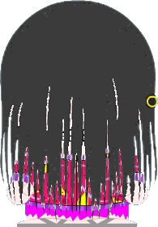
Testing Code Stylometry
jen’.c
bob.c
eve.c
jon.c
?
Train
Who?
van.c
sam.c
jen.c
Caliskan-Islam, et al., De-anonymizing Programmers via Code Stylometry
Notes:
Code stylometry is the process of determining who wrote a particular piece of code.
This can be useful to determine the provenance of malware, for example.
The way this works is,
You first train you system on code samples from a group of programmers
Then you use this trained system to determine the person who likely wrote a particular piece of unknown code.
To see how well their system works when malware writers use obfuscation to prevent detection, these researchers used Tigress to obfuscate the unknown program.

Slide 111





WebAssembly Obfuscation
P.js
P’.js
Javascript
Obfuscator
P.c
P.wasm
P’.wasm
Notes:
If you’re a web developer and want to protect your code running on browsers, what can you do?
Well, you could use a javascript obfuscator, but, the free ones are bad, the good ones are not free.
So, what else can you do?
Well, these days, all the major browser vendors support WebAssembly, which is bytecode that runs in the browser.
So, instead of writing your code in JavaScript, you can write it in C, run it through emscripten, which is a C to WebAssembly compiler, and then run this code in any browser.
This allows us to put Tigress in the chain: write your web application in C, obfuscate it with Tigress, compile it to WebAssembly using emscripten, and now you can run highly obfuscated code in any browser.

Slide 112
Commercial Efforts
?
?
Notes:
We also get occasional requests from industry to use Tigress.
I’ve been told that you will be able to buy devices at Best Buy protected with Tigress, and that’s kind of cool.
Less cool, scary even, is that I’ve gotten requests from the auto industry…

Slide 113



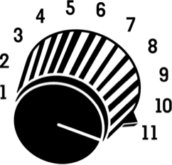


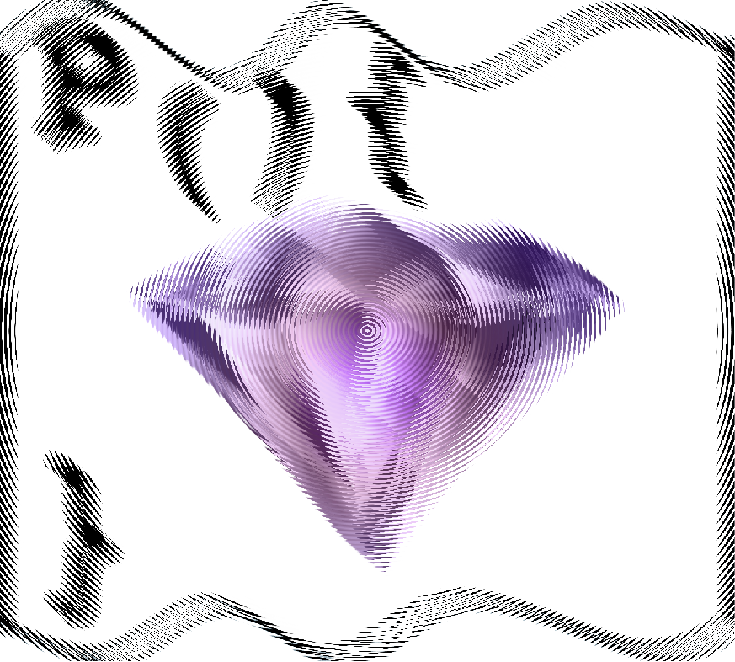
Update
Rate
P.c
Obfuscation
Rate
if (screenshot)
alert_sender;
Collberg, et al., Distr. app. tamper detection via continuous softw. updates
Notes:
In the beginning we looked at how Bob was hacking the SnapChat client on his phone.
These scenarios are well suited to implement a diversified system.
So, what we will do is to continuously send new code updates to Bob, he will hack them, of course, but then we generate a new version, he hacks it again, we send a new version, and so on.
But then, we can increase the update rate and the obfuscation rate, until Bob is no longer able to keep up.

Slide 114
Evaluating (De-)Obfuscation
Virtualize
NEXTINSTR[VPC]
Dispatch=…
ISA=…
Random
De-Virtualize
Bench-
marks
NEXTINSTR[VPC]
Notes:
But, the most important application of Tigress is to help evaluate the strength of obfuscating transformations.
So, say that someone has developed a new reverse-engineering attack, for example de-virtualization. Of course, they want to evaluate it: how close is the de-obfuscated code compared to the original, and how much resources are needed to perform the attack?
So, what should they do?
They can run some benchmarks through Tigress to generate obfuscated samples to attack and see how this affects the precision and resource requirements of the attack.
Finally, if you don’t have enough benchmarks available, you can easily generate millions of random programs, and obfuscate them randomly, all without leaving Tigress!

Slide 115

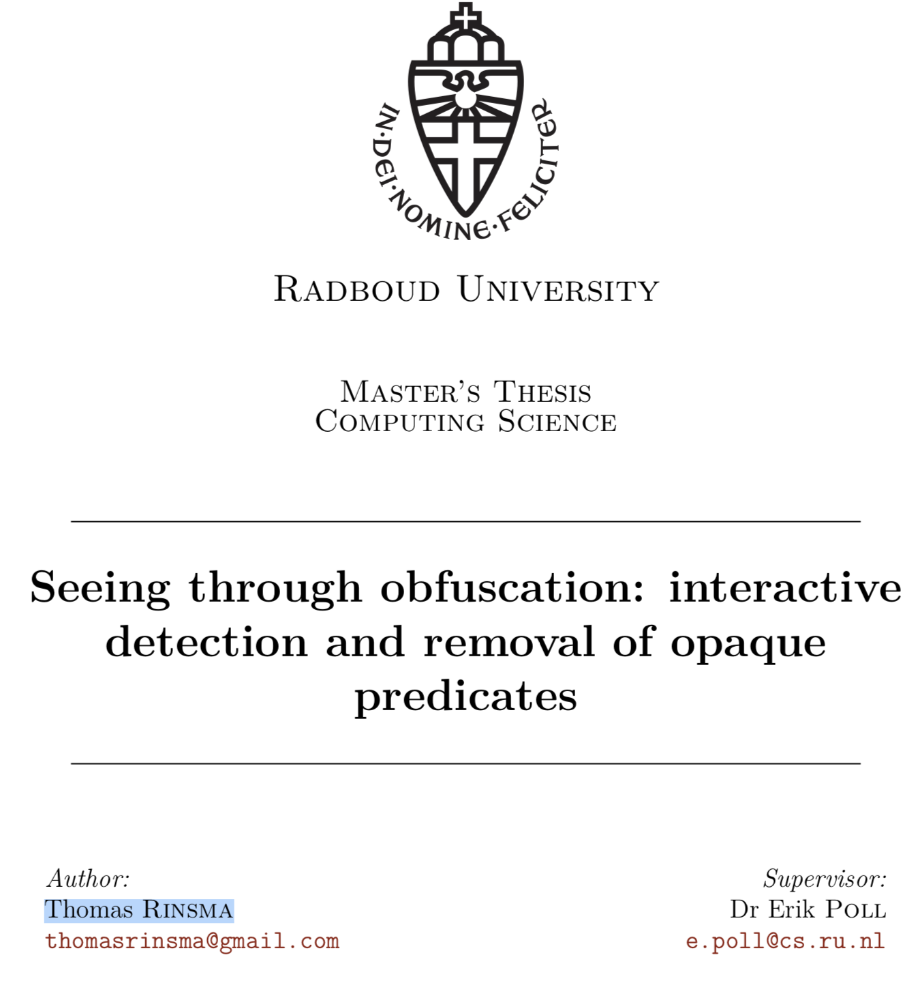

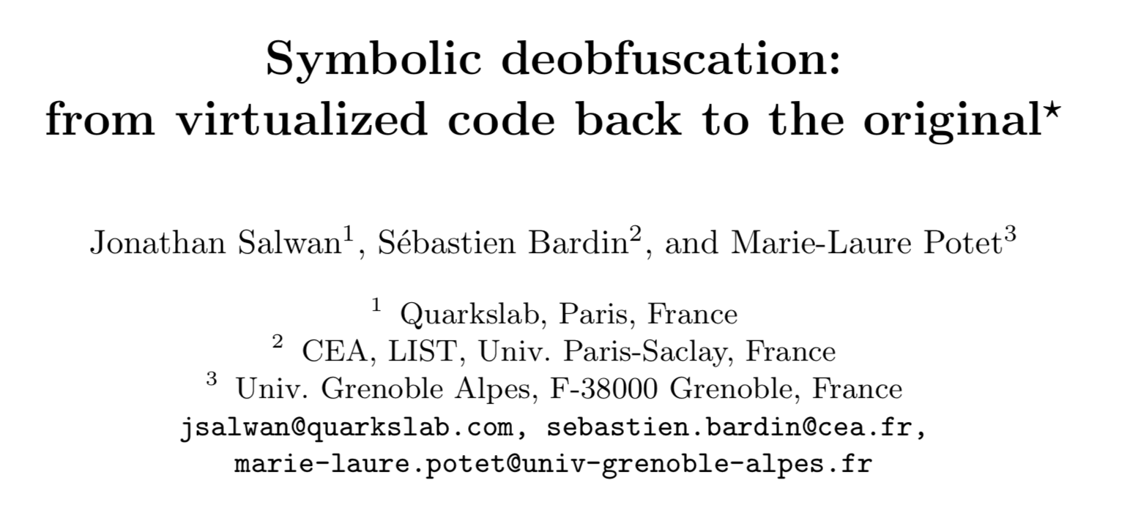


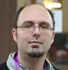

Evaluating (De-)Obfuscation
Program | Performance
Tigress Challenge 3.4 | 2.2 hours, 170GB RAM
Notes:
But, the most important application of Tigress is to help evaluate the strength of obfuscating transformations.
For example, Jonathan Salwan and his co-authors show how to attack virtualized code generated by Tigress. They show, for example, that they can unravel one of Tigress’ generated challenges in 2.2 hours, using 170 GB of RAM.
And, here’s another example, in his Master’s thesis, Thomas Rinsma explores how to attack Tigress’ opaque predicates.
This is exactly the reason that I built Tigress in the first place: It finally gives academics a reasonable target to attack. This is something we have been missing for many years.

Slide 116
Complete | — | one of every kind of transform
Generic | — | many transform variants
Diverse | — | every decision influenced by seed
Extensible | — | easy to add new transforms
Useful | — | works on real programs
Notes:
So, today I have tried to describe the design of an obfuscator.
The design philosophy, as you have seen, is to make a tool that is complete, generic, diverse, extensible, and useful.
Complete means that every kind of obfuscating transformation should be available;
Generic means that every transformation should exist in multiple variants, to prevent against pattern-matching attacks;
Diverse means that by giving different seeds to Tigress, we can generate many different obfuscated versions;
Extensible means we should easily add new transforms;
and, finally, useful means that it works on real programs.

Slide 117
Thank You!
!uoY knahT
collberg.cs.arizona.edu
tigress.cs.arizona.edu
RevEngE.cs.arizona.edu
Supported by NSF CNS-1525820
Thanks to my collaborators:
Taylor, Debray, Stephens, Yadegari, Scheidegger
Notes:
And, with that I would like to conclude.
I invite you to check out Tigress, it is freely downloadable from our website, and as you’ve seen, it has lots of interesting applications.
And I encourage you to tell your students to try their hand at our challenges, and maybe win lots of money!
Thank you!

Slide 118

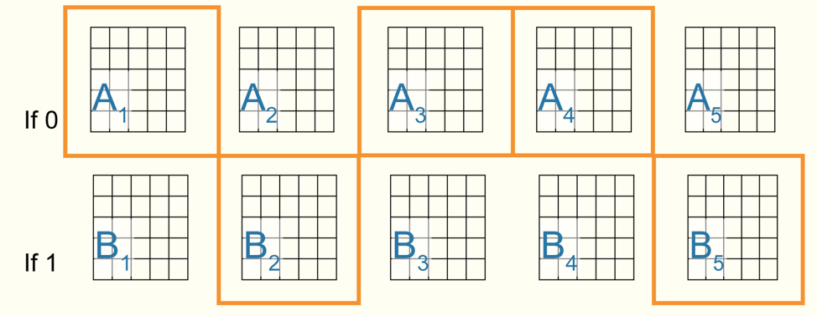

≈
Language-Based
Obfuscation
MATE
Defenses
Secure
Hardware
Crypto-Based
Obfuscation
Notes:
What I have failed to mention so far is that there are actually 3 different techniques to defend against MATE attacks.
The first one is what I’ve been talking about today, namely language-based obfuscation.
A second technique is to use hardware protection. Intel has its SGX secure enclaves, and ARM has its TrustZone.
The third technique is crypto-based obfuscation.
And all these techniques have their pros and cons.

Slide 119
Crypto-Based Obfuscation
Program | Generate | Run
2-bit multiplier | 1027 years | 10⁸ years
16-bit point function | 7 hours, 25G | 4 hours (later, 20 minutes)
Strong security guarantees
Performance issues
Notes:
And, finally, there’s crypto-based obfuscation
This is very interesting, because it provides strong security guarantees.
Unfortunately, currently, the performance hit makes these techniques not yet practical.
I’m aware of 2 current implementations.
The most well known one is a challenge posed at Crypto a few years ago to deobfuscate a 16-bit point function. The size of the challenge was 25GB, and it took 4 hours to run.
A 2 bit-multiplier would take over 1000 years to generate, and 100 million years to run.
However, this is a new area, and we can hope for breakthroughs.

